Slide 1
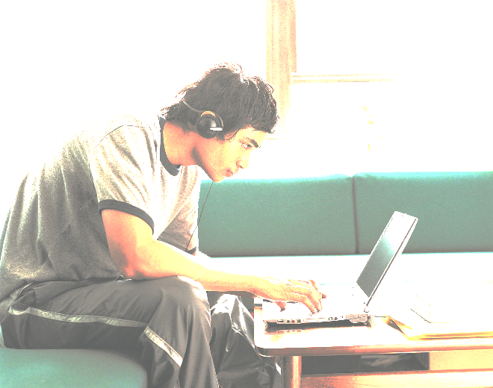
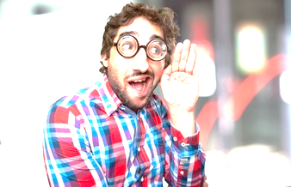
INTRODUCTION
AIRMOUSE, Hand Gesture Recognition application is an expository to nullify physical connection between a user and a system.
It helps a system to analyze the gestures made by a user and perform the desired or corresponding tasks.

Slide 2
PURPOSE
This Project enables a user to overcome the physical barriers between a user and a System and thus reduces the mechanical wear and tear of the system.
Also it increases durability of that system, making process of maintenance easier for a user.
It also enables us to control all the Music Player operations with ease.

Slide 3
GOALS AND OBJECTIVIES
Reliability
Low-Cost
Maintainability
Portability
Performance
Usability
Time
User-Friendly
Availability

Slide 4
TECHNOLOGIES
OPENCV: Open-source Computer Vision library focused on real-time image processing.
PYTHON: Python is a widely used general-purpose, high-level programming language.
Python is interpreted.
Python is Interactive.
Python is Object-Oriented.
Python is a Beginner's Language.

Slide 5
TECHNOLOGIES
NUMPY: Fundamental package for scientific computing with Python.
PYGLET: Library that provides an object-oriented application programming interface for the creation of games and other multimedia applications.
MATH: Free & available, provides access to mathematical functions defined by C standard.
PYCHARM: Unlike a regular text editor, Pycharm knows python and is built from the ground upto deal with code, not text.

Slide 6
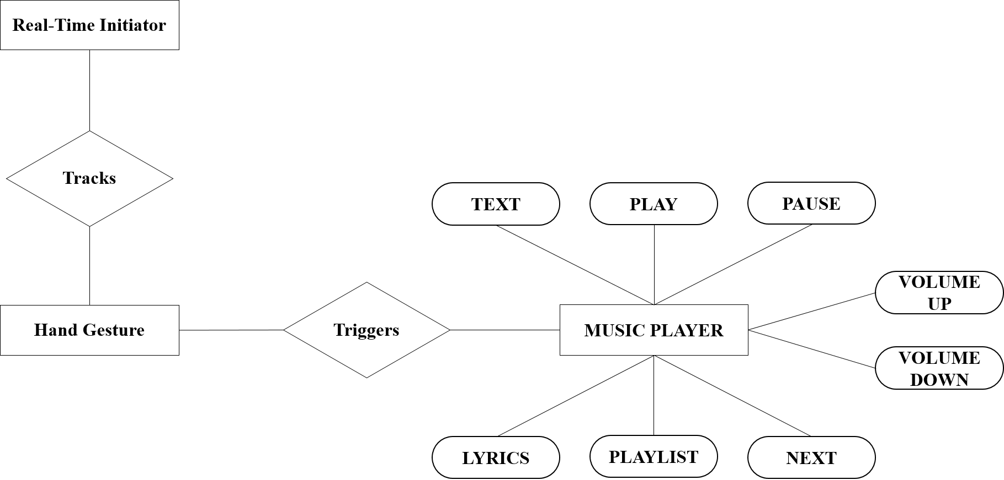
ENTITY-RELATIONSHIP DIAGRAM

Slide 7
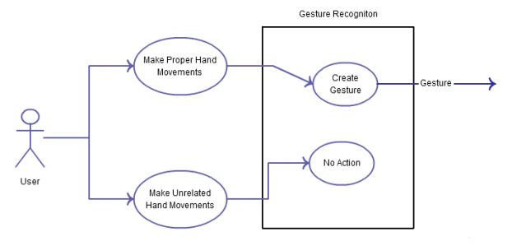
USE-CASE DIAGRAM

Slide 8
USE-CASE DIAGRAM
Play Music
User
System
Volume UP
Play Music
Play Next
Volume Down
Pause
Playlist
Lyrics

Slide 9
DATA FLOW DIAGRAM
Provides Gestures
0.0
Gesture
Recognition System
User
Media Player Services, Plain Text
Level 0

Slide 10
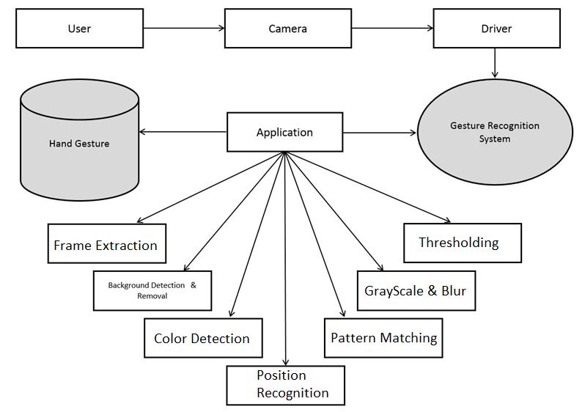
DATA FLOW DIAGRAM
Level 1

Slide 11
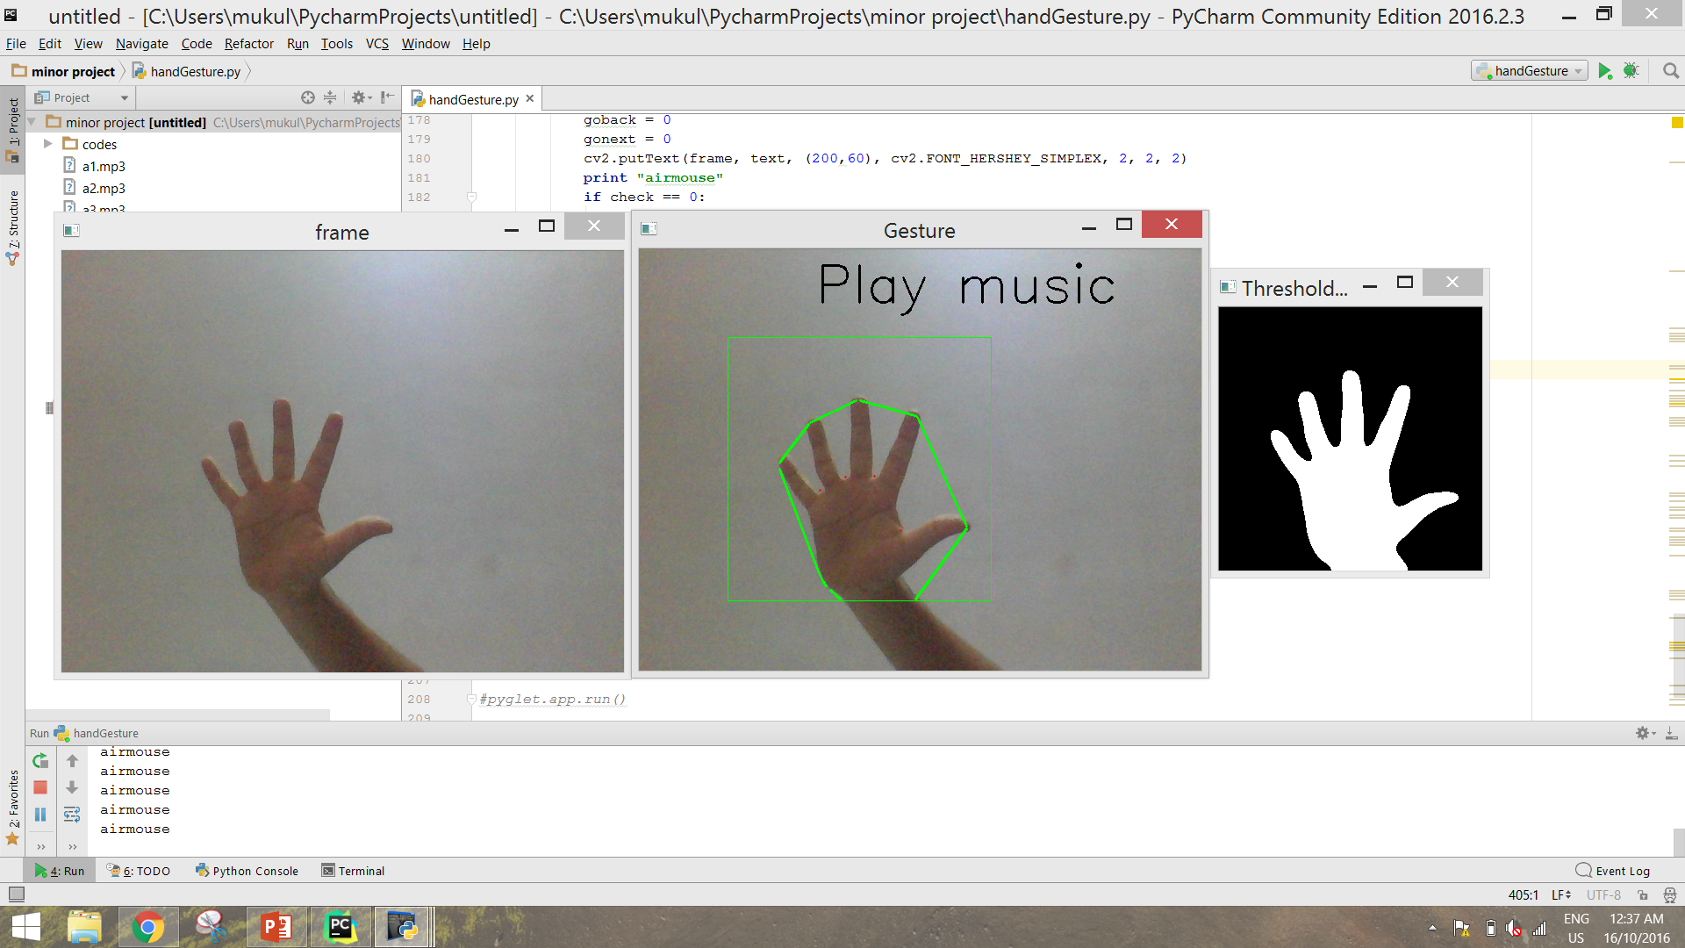
CAPTURING FRAMES

Slide 12
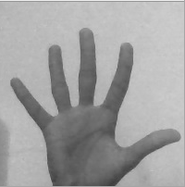
RGB TO GRAYSCALE
The captured image is then converted from RGB to grayscale and then to binary in order to find the ROI i.e. the portion of the image which are further used for image processing.

Slide 13
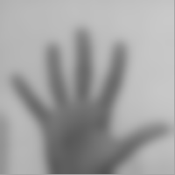
BLURRING : GAUSSIAN BLUR
By blurring, the image is created smooth transition from one color to another and reduce the edge content.

Slide 14
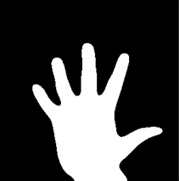
THRESHOLDING
OpenCV automatically calculates & approximates the threshold value of a bimodal image from its image histogram.
But for optimal results, a clear background in front of the webcam is required which sometimes may not be possible.

Slide 15
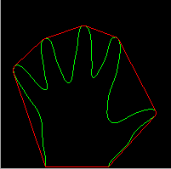
DRAWING COUNTORS

Slide 16
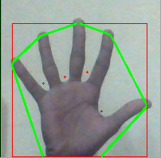
CONVEX HULL, CONVEXITY DEFECTS
The convex points are generally, the tip of the fingers.
Convexity Defects are also searched, which is the deepest point of deviation on the contour. (RED POINTS)

Slide 17
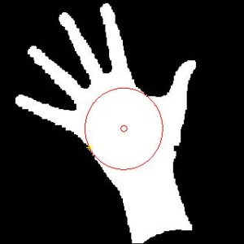
PLOTTING CENTROID
Centroid of the frame is calculated, so that relative position of the hand is recognized and from that hand positions relative function is invoked.

Slide 18
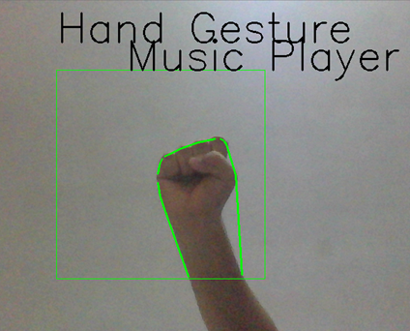
HAND POSITIONS
When the hand is
Far Left from the Centroid.
Far Right from the Centroid.
Far above the Centroid.
Far below the Centroid.
Near or on the Centroid.

Slide 19
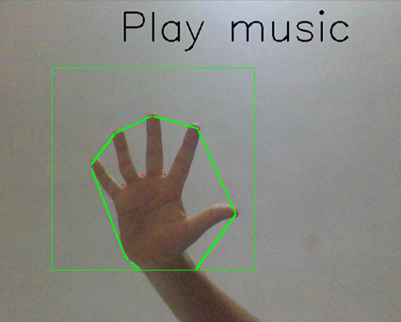
HAND POSITIONS : CENTER

Slide 20
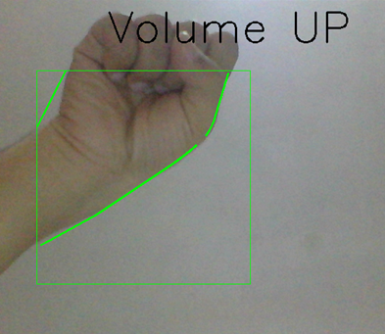
HAND POSITIONS : ABOVE

Slide 21
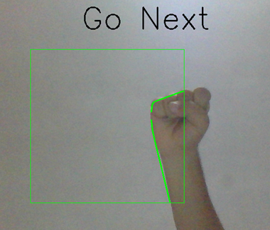
HAND POSITIONS : RIGHT

Slide 22
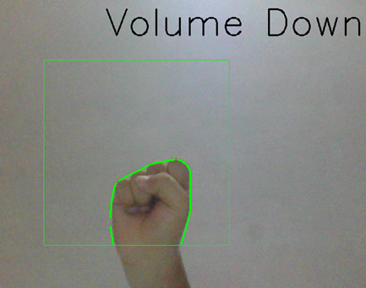
HAND POSITIONS : BELOW

Slide 23
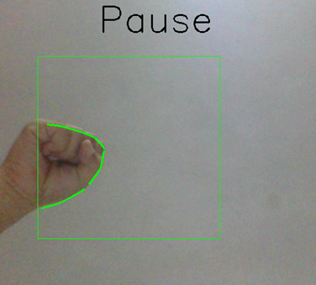
HAND POSITIONS : LEFT

Slide 24
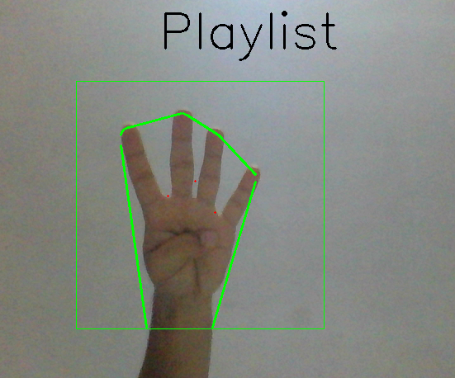
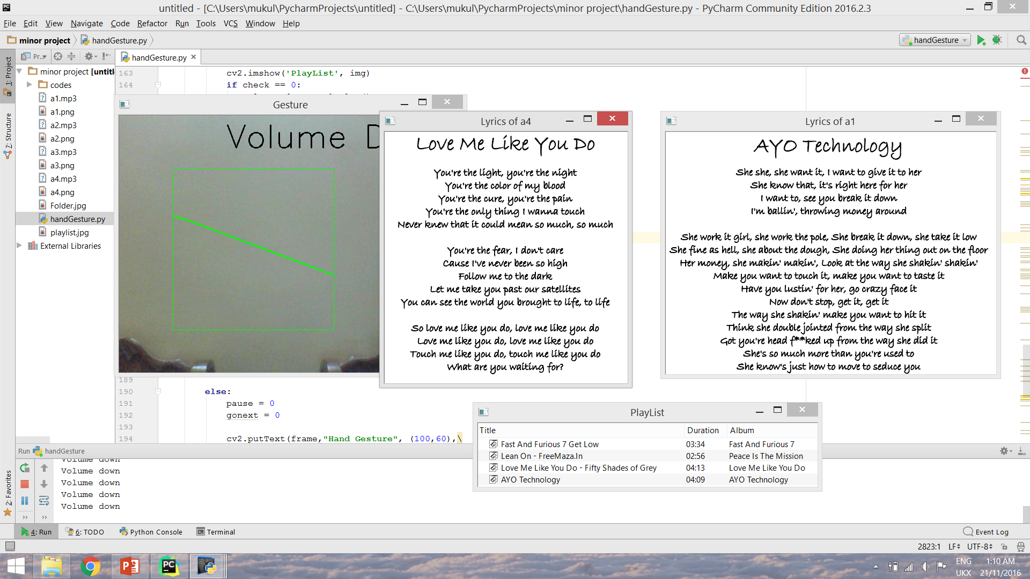
HAND POSITIONS : CENTER

Slide 25
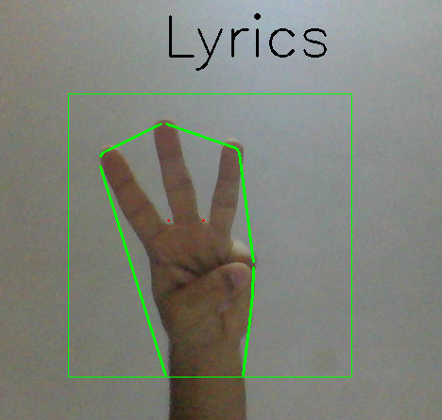
HAND POSITIONS : CENTER

Slide 26
SUMMARY
AirMouse a hand gesture recognizer.
Operates Music Player.
For Playing, Pausing, Increasing & Decreasing Volume, Playing Next Track, Viewing Playlist & Viewing Lyrics.
Displays Plain Text on output screen.
With No Physical Contact.

Slide 27
CONCLUSIONS AND FUTURE SCOPE
The AIRMOUSE Project is a small effort to reduce the physical communication between the User and the System.
As the growing demand on rapid and quick technical support, this system is carefully designed to fit with the rapid technical support.
This System controls the Music Player and its Functions through Hand Gestures.
In future it can be taken forward to make control over other utilities and applications and improve to reduce Physical Communication between the User and the Device.

Slide 28
LIMITATIONS
The present application though seems to be feasible and more user friendly.
Recognizing hand up to 25 cm gives better performance.
An attempt to make the input modes less constraints dependent for the users, hand gestures has been preferred.

